Slide 1

CS1951 L
Blockchains & Cryptocurrencies
Spring 2025
Lecture 9
Solidity Pitfalls and Hazards
(Part One)
Maurice Herlihy
Brown University

Slide 2
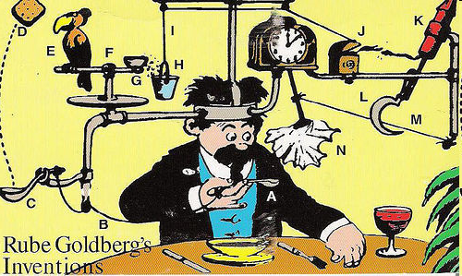
Javascript
Intended for web page presentation
Odd, complex behavior considered normal
No precise notion of correctness
Must be “easy” for non-experts
No actual adversary

Slide 3

What could possibly go wrong?
Why not use a web-scripting language
for irrevocable financial transfers?
small errors can be catastrophic?
precise definitions matter?
corner cases matter?
Language design is hard, and not for amateurs

Slide 4

Your code review
Buon Giorno!
你好!
Здравствуйте!
여보세요!
שלום!

Slide 5
Next Four Lectures
Review 16 Vulnerabilities
Some common to all blockchains
Some are Solidity idiosyncrasies …
"nonsense is nonsense, but the history of nonsense is scholarship"

Slide 6

Re-Entrancy Attack
Call external contract …
Who unexpectedly calls you back …
When you were not expecting visitors!

Slide 7
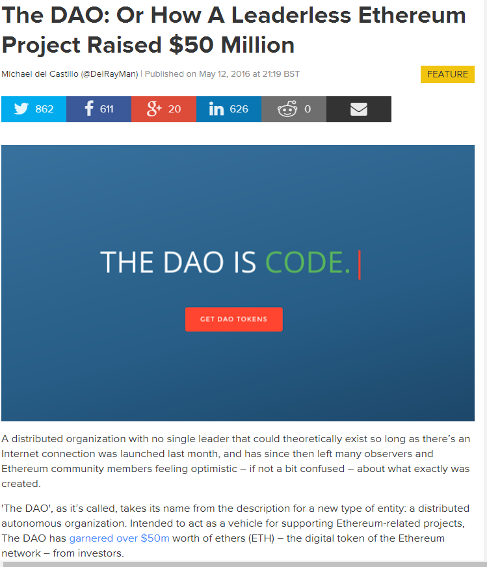
An Application
DAO = Decentralized Autonomous Organization
Invests in other businesses: about $50 Million capital
In Ether cryptocurrency
No managers or board of directors
Controlled by smart contacts and investor voting

Slide 8
DAO = Decentralized Autonomous Organization
“code is law”
Invests in other businesses: about $50 Million capital
In Ether cryptocurrency
No managers or board of directors
Controlled by smart contacts and investor voting

Slide 9
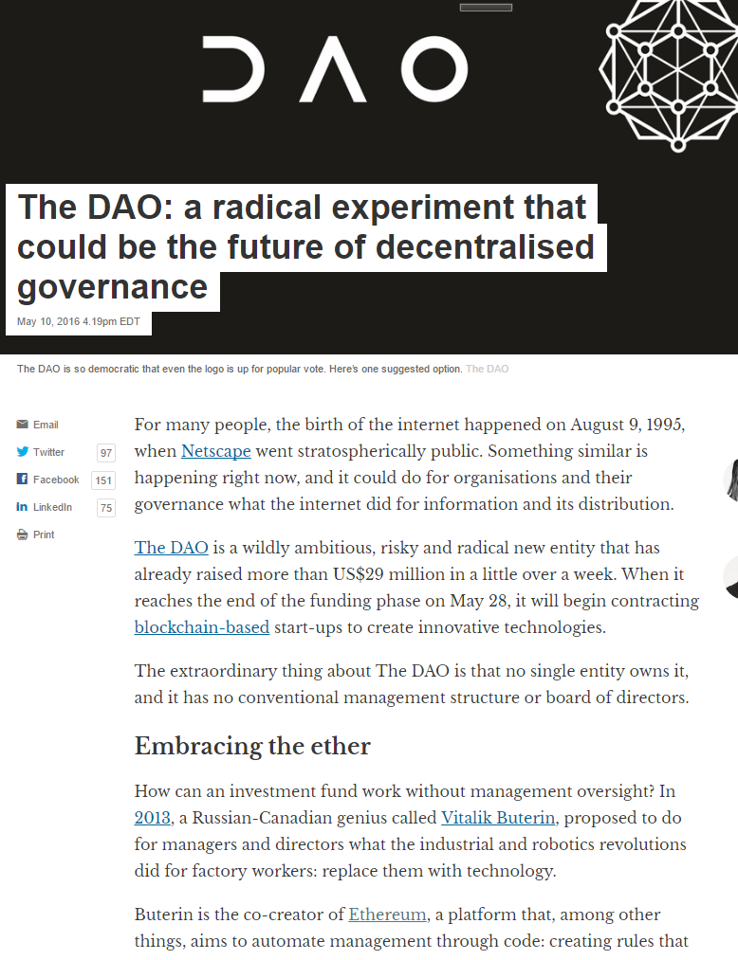
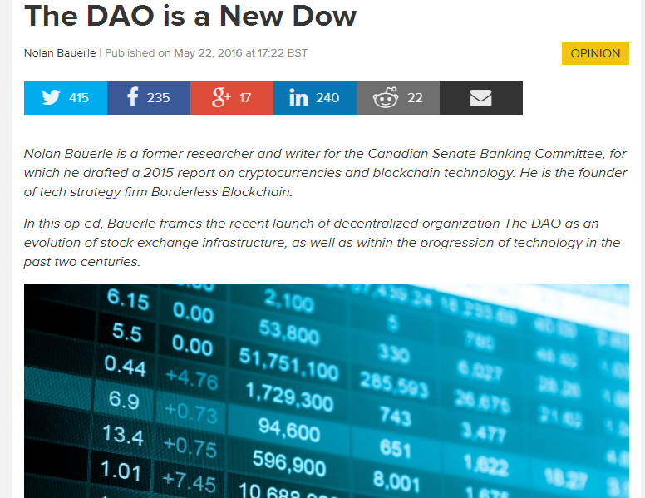
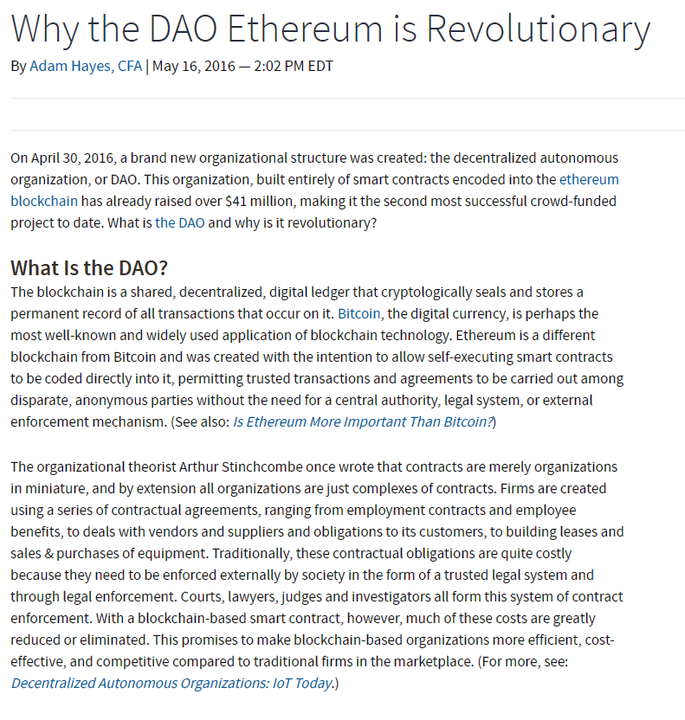
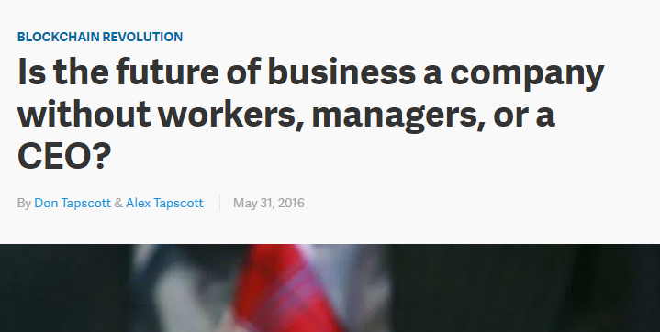
Much hyperventilation about effect on future of finance

Slide 10
Schematic DAO Code
function withdraw(uint amount) {
client = msg.sender;
if (balance[client] >= amount} {
if (client.call.sendMoney(amount)) {
balance[client] -= amount;
}}}
Client wants to withdraw own money
10
Notes:
10

Slide 11
Schematic DAO Code
function withdraw(uint amount) {
client = msg.sender;
if (balance[client] >= amount} {
if (client.call.sendMoney(amount)) {
balance[client] -= amount;
}}}
Which client?
11
Notes:
11

Slide 12
Schematic DAO Code
function withdraw(uint amount) {
client = msg.sender;
if (balance[client] >= amount} {
if (client.call.sendMoney(amount)) {
balance[client] -= amount;
}}}
Does client have enough money?
12
Notes:
12

Slide 13
Schematic DAO Code
function withdraw(uint amount) {
client = msg.sender;
if (balance[client] >= amount} {
if (client.call.sendMoney(amount)) {
balance[client] -= amount;
}}}
Transfer the money by calling a function in another contract …
13
Notes:
13

Slide 14
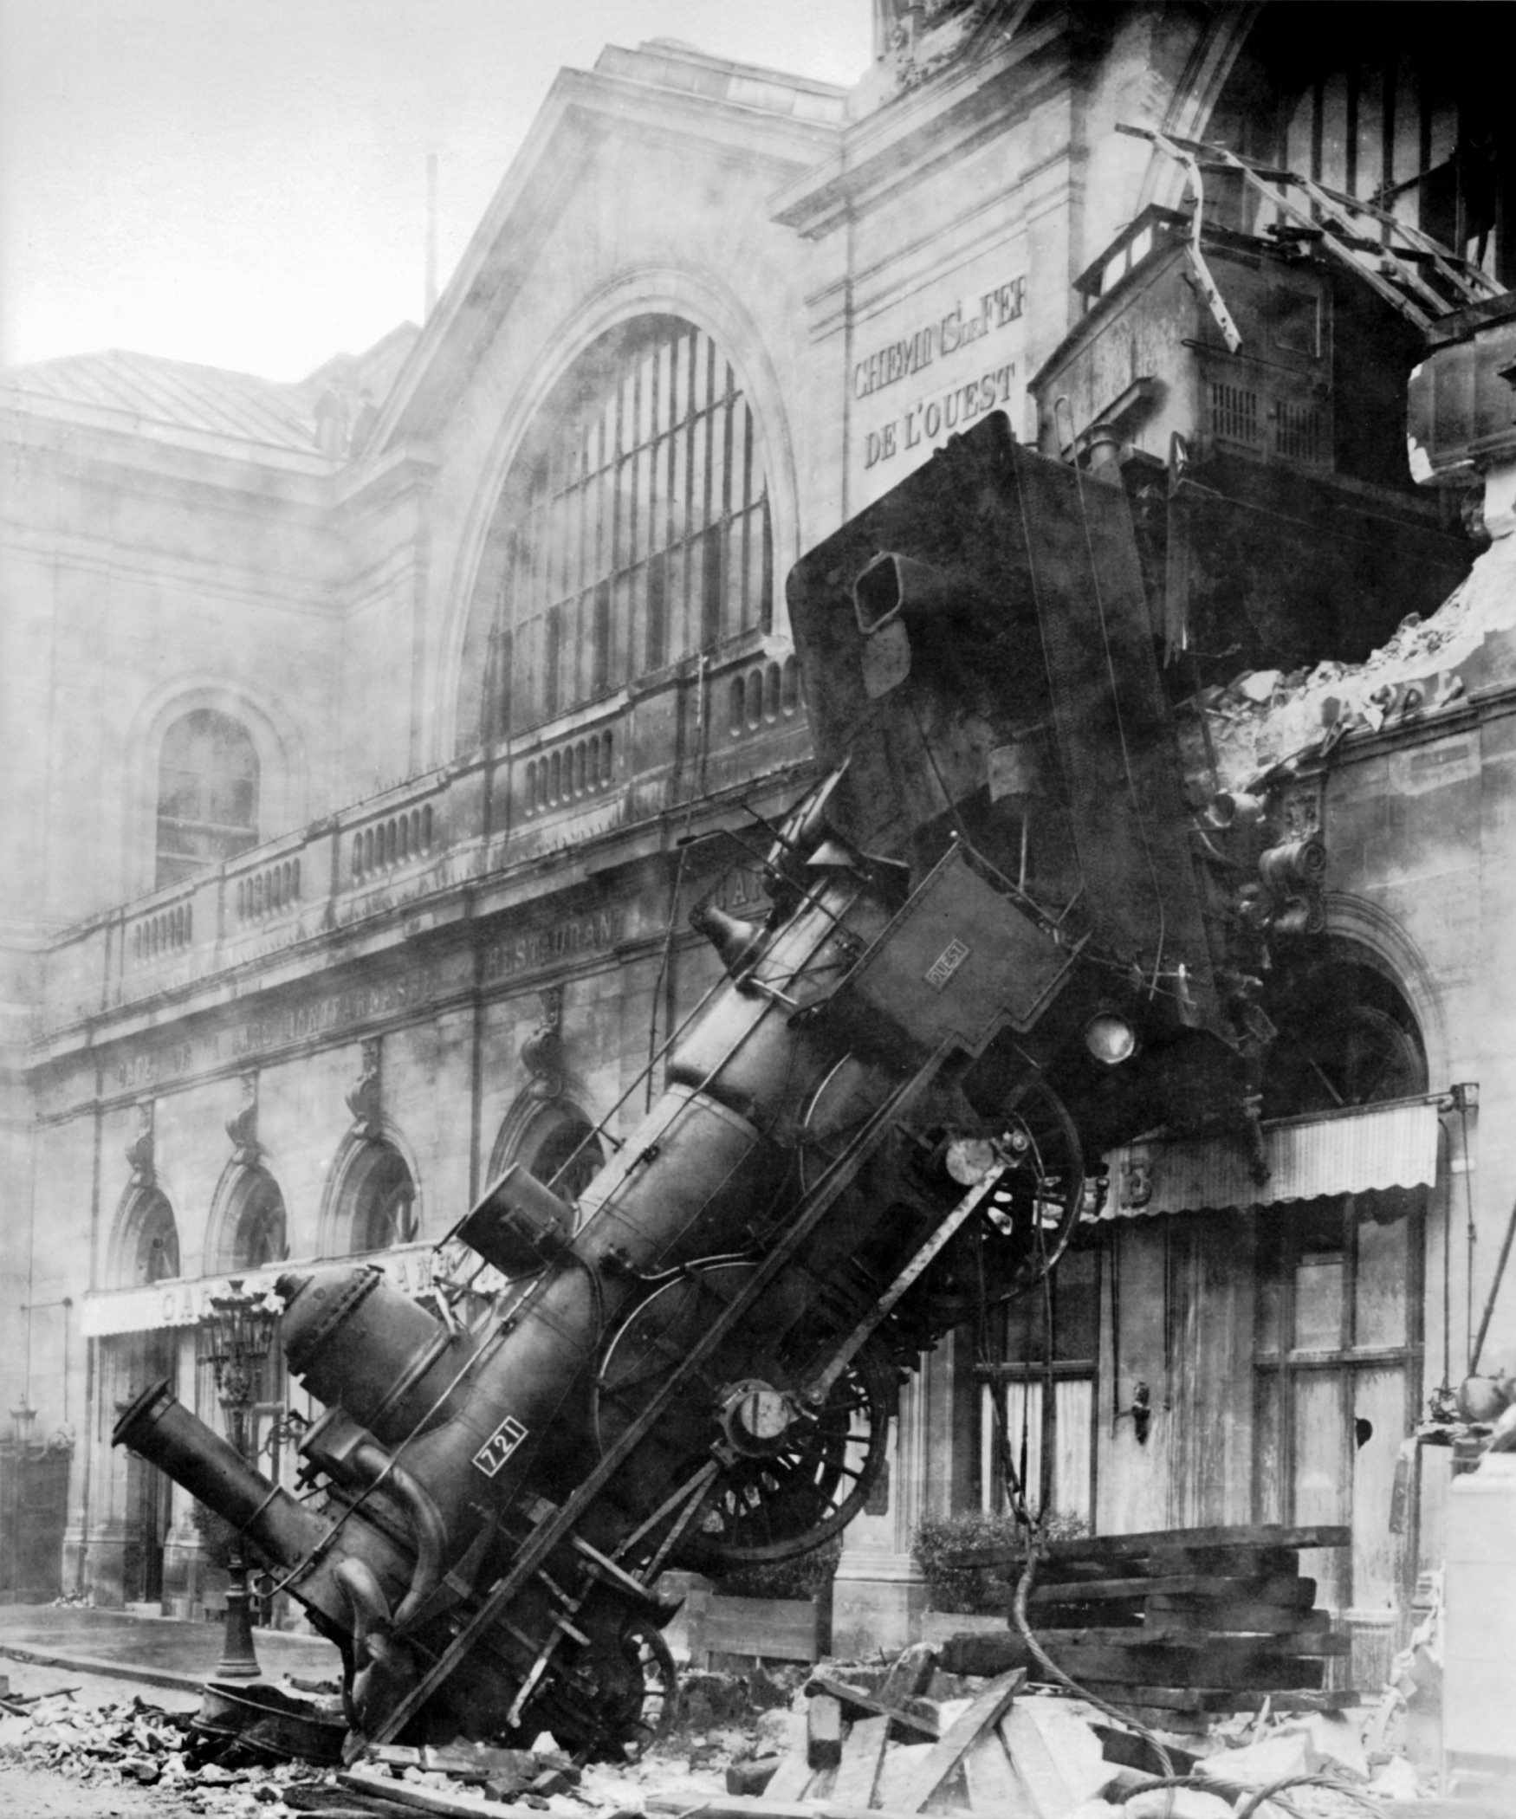
Schematic DAO Code
function withdraw(uint amount) {
client = msg.sender;
if (balance[client] >= amount} {
if (client.call.sendMoney(amount)) {
balance[client] -= amount;
}}}
Let’s rewind …
14
Notes:
14

Slide 15
function withdraw(uint amount) {
client = msg.sender;
if (balance[client] >= amount} {
if (client.call.sendMoney(amount)) {
balance[client] -= amount;
}}}
Transfer the money by calling another contract …
function sendMoney(uint amount) {
balance += amount
msg.sender.call.withdraw(amount)
...
}
15
Notes:
15

Slide 16
function withdraw(uint amount) {
client = msg.sender;
if (balance[client] >= amount} {
if (client.call.sendMoney(amount)) {
balance[client] -= amount;
}}}
Credit account
function sendMoney(uint amount) {
balance += amount
msg.sender.call.withdraw(amount)
...
}
16
Notes:
16

Slide 17
function withdraw(uint amount) {
client = msg.sender;
if (balance[client] >= amount} {
if (client.call.sendMoney(amount)) {
balance[client] -= amount;
}}}
Wait, what?
Client makes “re-entrant” withdraw request!
function sendMoney(uint amount) {
balance += amount
msg.sender.call.withdraw(amount)
...
}
17
Notes:
17

Slide 18
function withdraw(uint amount) {
client = msg.sender;
if (balance[client] >= amount} {
if (client.call.sendMoney(amount)) {
balance[client] -= amount;
}}}
function sendMoney(uint amount) {
balance += amount
msg.sender.call.withdraw(amount)
...
}
18
Notes:
18

Slide 19
function withdraw(uint amount) {
client = msg.sender;
if (balance[client] >= amount} {
if (client.call.sendMoney(amount)) {
balance[client] -= amount;
}}}
Second time around, balance still looks OK …
function sendMoney(uint amount) {
balance += amount
msg.sender.call.withdraw(amount)
...
}
19
Notes:
19

Slide 20
function withdraw(uint amount) {
client = msg.sender;
if (balance[client] >= amount} {
if (client.call.sendMoney(amount)) {
balance[client] -= amount;
}}}
Send money again …
and again and again …
function sendMoney(uint amount) {
balance += amount
msg.sender.call.withdraw(amount)
...
}
20
Notes:
20

Slide 21
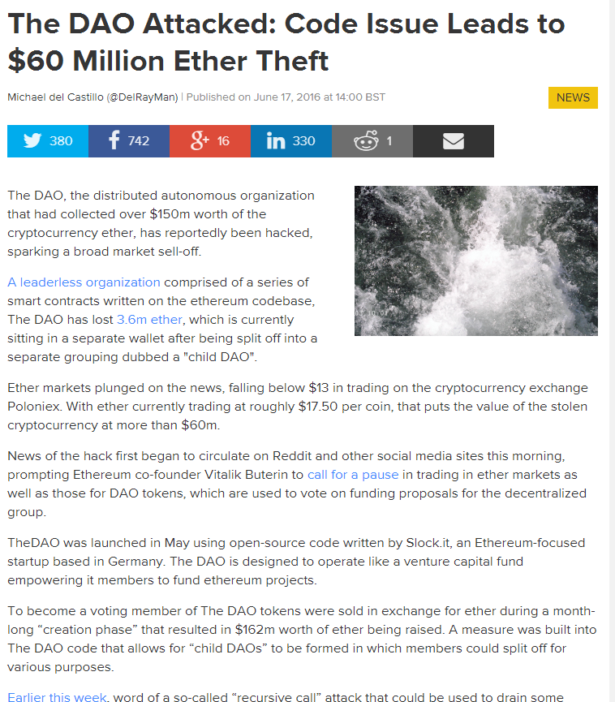
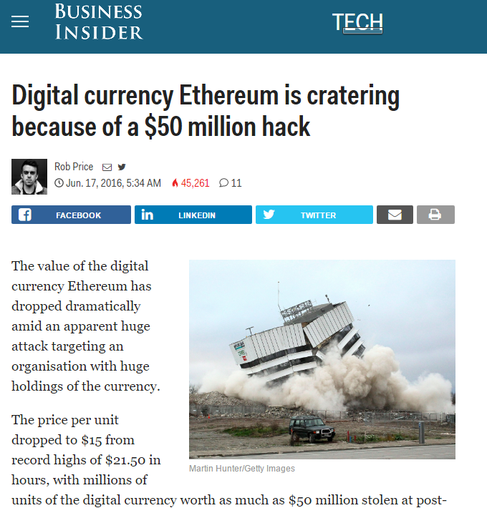
This happened
“ The attack is a recursive calling vulnerability, where an attacker called the “split” function, and then calls the split function recursively …”
The actual fix?

Slide 22
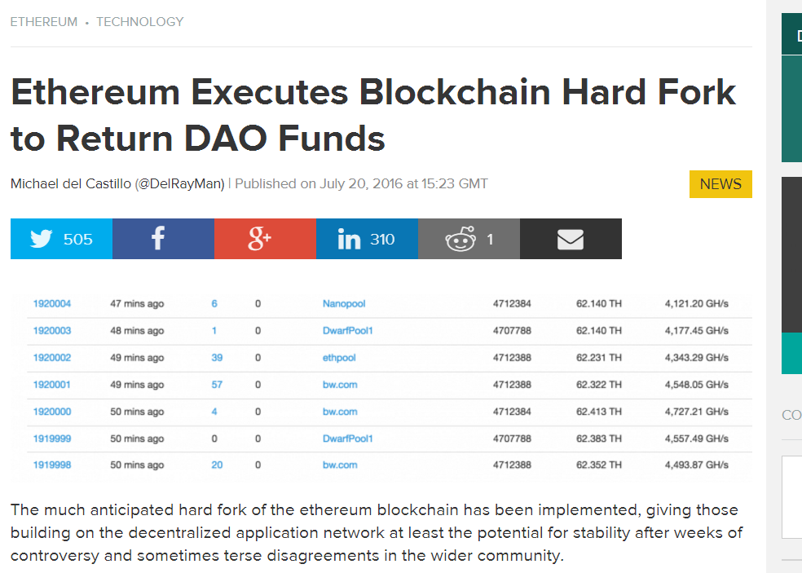
The Fix?
22
Notes:
22

Slide 23
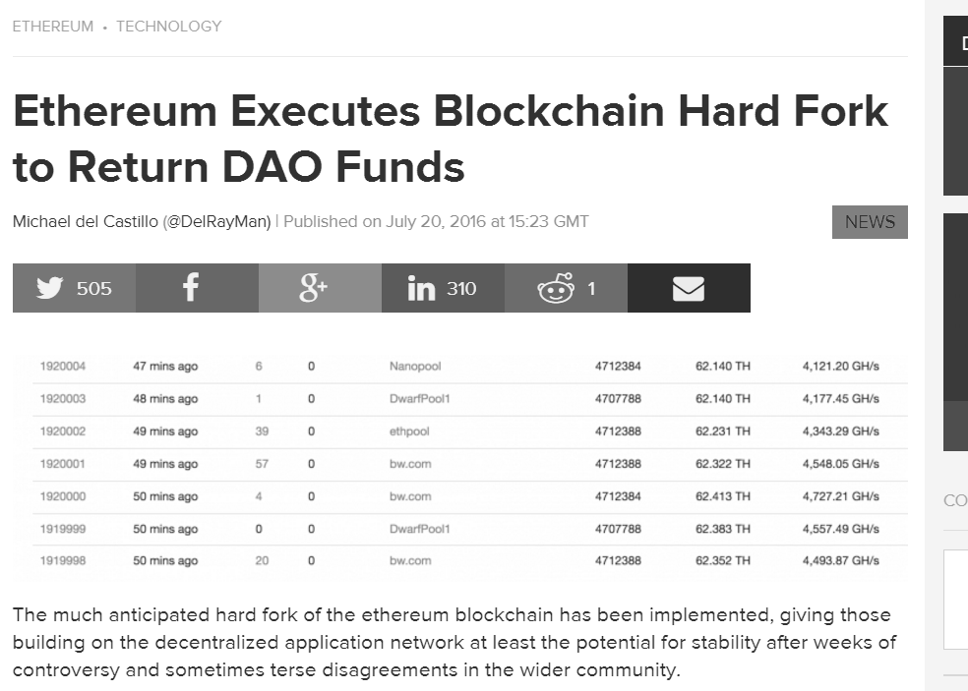
The Fix?
Hard-Fork Ethereum and roll back …
LOL, just kidding about that “code is law” thing …
Because language design is hard
23
Notes:
23

Slide 24
Rationale for Hard Fork
Client did something stupid?
Client’s fault, no refund.
Bug in Ethereum run-time system?
Ethereum’s fault, refund.
No warning about reentrancy vulnerability?
Ethereum’s fault, refund.

Slide 25
I don’t care what you say …

Slide 26
This talk is not about Bitcoin
This is a concurrency error

Slide 27
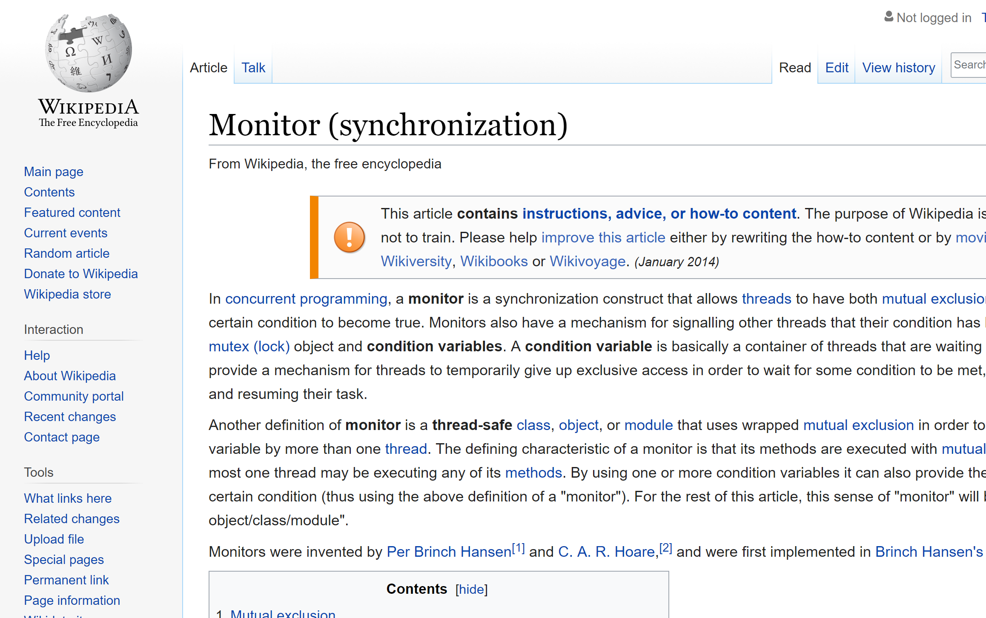
Classical “monitor lock” pitfall
Calling another contract =
releasing monitor lock
Don’t violate invariants before a call

Slide 28
Prevention
Change state before any external calls
Use a mutex
Use transfer() function
(too little gas to call back)

Slide 29
Silent Overflow Attack
uint8 x = 0;
uint8 y = x – 1; // y is 255!
int and uint variables have fixed ranges
Older EVM quietly rolls over on over/under flow
Not exactly what you expected

Slide 30
Example
contract Token {
mapping(address => uint) balances;
uint public totalSupply;
constructor (uint _initialSupply) public {
balances[msg.sender] =
totalSupply = _initialSupply;
}
…
}

Slide 31
Example
contract Token {
mapping(address => uint) balances;
uint public totalSupply;
constructor (uint _initialSupply) public {
balances[msg.sender] =
totalSupply = _initialSupply;
}
…
}
simple token contract

Slide 32
Example
contract Token {
mapping(address => uint) balances;
uint public totalSupply;
constructor (uint _initialSupply) public {
balances[msg.sender] =
totalSupply = _initialSupply;
}
…
}
keep track of each client’s balance

Slide 33
Example
contract Token {
mapping(address => uint) balances;
uint public totalSupply;
constructor (uint _initialSupply) public {
balances[msg.sender] =
totalSupply = _initialSupply;
}
…
}
constructor

Slide 34
Example
pragma solidity ^0.5.2;
contract Token {
…
function transfer(address _to, uint _value)
public returns (bool) {
require(balances[msg.sender] - _value >= 0);
balances[msg.sender] -= _value;
balances[_to] += _value;
return true;
}
transfer caller’s tokens to another client
return success code

Slide 35
Example
pragma solidity ^0.5.2;
contract Token {
…
function transfer(address _to, uint _value)
public returns (bool) {
require(balances[msg.sender] - _value >= 0);
balances[msg.sender] -= _value;
balances[_to] += _value;
return true;
}
Make sure caller has enough tokens

Slide 36
Example
pragma solidity ^0.5.2;
contract Token {
…
function transfer(address _to, uint _value)
public returns (bool) {
require(balances[msg.sender] - _value >= 0);
balances[msg.sender] -= _value;
balances[_to] += _value;
return true;
}
do the transfer

Slide 37
You Got a Problem with That?
pragma solidity ^0.5.2;
contract Token {
…
function transfer(address _to, uint _value)
public returns (bool) {
require(balances[msg.sender] - _value >= 0);
balances[msg.sender] -= _value;
balances[_to] += _value;
return true;
}

Slide 38
You Got a Problem with That?
pragma solidity ^0.5.2;
contract Token {
…
function transfer(address _to, uint _value)
public returns (bool) {
require(balances[msg.sender] - _value >= 0);
balances[msg.sender] -= _value;
balances[_to] += _value;
return true;
}
This difference is always positive,
test passes even if client has zero balance!

Slide 39
Fixed in Solidity 0.80
Underflow/overflow causes run-time error
What if you want wrap-around?
pragma solidity ^0.8.0;
unchecked {
myUint8--; // YOLO
}

Slide 40

This Happened
“Proof of Weak Hand” token price …
Increases when bought
Decreases when sold
Pays dividends on sales while you hold
Lasted 3 days …

Slide 41
This Happened
Account 1
Account 2
Balance: 1
Balance: 0
function transferFrom (address _from, uint _amt) {
require( balance[_from] > _amt);
balance[msg.sender] -= _amt;
…
}

Slide 42
This Happened
Account 1
Account 2
Balance: 1
Balance: 0
function transferFrom (address _from, uint _amt) {
require( balance[_from] > _amt);
balance[msg.sender] -= _amt;
…
}
Does source have enough money?

Slide 43
This Happened
Account 1
Account 2
Balance: 1
Balance: 0
function transferFrom (address _from, uint _amt) {
require( balance[_from] > _amt);
balance[msg.sender] -= _amt;
…
}
Debit source account …
Oh, wait …

Slide 44
This Happened
Account 1
Account 2
Balance: 1
Balance: 0xff..ff
function transferFrom (address _from, uint _amt) {
require( balance[_from] > _amt);
balance[msg.sender] -= _amt;
…
}
Debited wrong account!

Slide 45
This Happened
Account 1
Account 2
Balance: 1
Balance: 0xff..ff
0 – 1 = ~115 quattuorvigintillion ETH
Actually absconded with ~$800K in Jan 2018

Slide 46
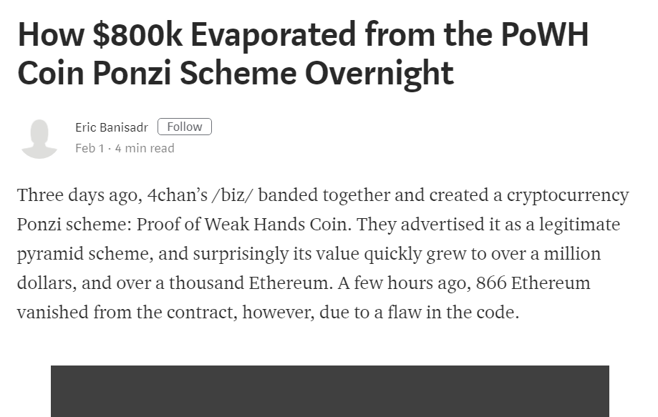
This Happened

Slide 47
Floating Point Precision
Solidity does not support fixed or floating point numbers
Beware of rolling your own
Round-off errors cause vulnerabilities

Slide 48
function buyTokens() public payable {
uint tokens =
msg.value / weiPerEth * tokensPerEth;
balances[msg.sender] += tokens;
}
The math looks correct…
But if value is less than 1 ether …
No tokens assigned

Slide 49
function buyTokens() public payable {
uint tokens =
msg.value / weiPerEth * tokensPerEth;
balances[msg.sender] += tokens;
}
The math is “correct” …
Fewer than tokensPerEth = 10 tokens will result in 0 ether
Rounding is always down

Slide 50
Prevention
Re-invent numerical analysis
Commutative ops don’t commute
convert variables into high precision
ratios and division are dangerous

Slide 51
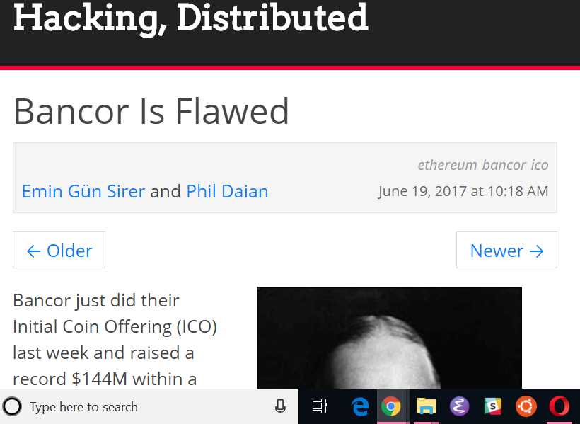
This Happened
“Bancor ended up reimplementing their own functions for arithmetic. That is, their own add, subtract, multiply, and exponentiation.”
“It's a mishmash of special numbers baked into the code.”
“Special magic constants litter Bancor code. So much so that we found it difficult to test this code for correctness ourselves.”
“And even simple rounding errors can be problematic in this game. ”

Slide 52
Unexpected Ether Attack
You can prevent others from taking your money
But you can’t stop them from sending you money
Surprisingly, this can be a bad thing

Slide 53
Sending Ether
destination.foo.value(1000)(arg)
send 1000 wei via
payable named function
contract destination {
function foo(uint arg) public payable {
…
}
}

Slide 54
Sending Ether
destination.transfer(1000);
send 1000 wei via
payable fallback function
contract destination {
fallback () external payable {
…
}

Slide 55
Controlling Ether Receipt
Ether receipt triggers …
Function, named or fallback
Possible to refuse ether by
reverting (throwing)
not being payable

Slide 56
Ether You Cannot Refuse
selfdestruct(destination);
send balance without
calling destination code
contract destination {
…
}

Slide 57
Example
Simple gambling game
Sequence of milestones (amounts)
Players send small ether amounts …
First player to reach each milestone wins!

Slide 58
contract EtherGame {
uint public targetAmount = 5 ether;
address public winner; function play() public payable {
require(msg.value == 1 ether, "1 Ether only"); uint balance = address(this).balance;
require(balance <= targetAmount, "Game is over"); if (balance == targetAmount) {
winner = msg.sender;
}
} …

Slide 59
contract EtherGame {
uint public targetAmount = 5 ether;
address public winner; function play() public payable {
require(msg.value == 1 ether, "1 Ether only"); uint balance = address(this).balance;
require(balance <= targetAmount, "Game is over"); if (balance == targetAmount) {
winner = msg.sender;
}
} …
each play must be 1 ether

Slide 60
contract EtherGame {
uint public targetAmount = 5 ether;
address public winner; function play() public payable {
require(msg.value == 1 ether, "1 Ether only"); uint balance = address(this).balance;
require(balance <= targetAmount, "Game is over"); if (balance == targetAmount) {
winner = msg.sender;
}
} …
Compute current balance

Slide 61
contract EtherGame {
uint public targetAmount = 5 ether;
address public winner; function play() public payable {
require(msg.value == 1 ether, "1 Ether only"); uint balance = address(this).balance;
require(balance <= targetAmount, "Game is over"); if (balance == targetAmount) {
winner = msg.sender;
}
} …
Player wins if it hits target amount

Slide 62
contract EtherGame {
uint public targetAmount = 5 ether;
address public winner; function play() public payable {
require(msg.value == 1 ether, "1 Ether only"); uint balance = address(this).balance;
require(balance <= targetAmount, "Game is over"); if (balance == targetAmount) {
winner = msg.sender;
}
} …
If adversary transfers 0.0001 ether via selfdestruct(), this.balance becomes slightly off, & comparison fails!

Slide 63
Prevention
Never rely on exact value of this.balance!
Have payable functions track own transfers

Slide 64
DelegateCall Attack
There are 2 ways to call other contracts’ functions
call executes in remote context
delegatecall executes in caller’s context
The distinction matters!

Slide 65
DelegateCall Opcode
Contract A
Contract B
delegatecall
Copy of
Contract B’s
code
copy code
A delegatecalls B’s function …
which runs in A’s address space

Slide 66
Composite Wallet
Wallet A
Wallet Library
(uninitialized)
Wallet B
Private data
Shared Code

Slide 67
Composite Wallet
Wallet A
Wallet Library
(uninitialized)
Wallet B
hardwired link
address constant _walletLibrary = 0x863df6b...;
Private data
Shared Code

Slide 68
Each Call
Wallet Library
(uninitialized)
Wallet B
Copy of
Wallet Library
code
Private data
Shared Code

Slide 69
Attack
initialize and
claim ownership
Wallet Library
(owned by
attacker)
Wallet B
Private data
Shared Code

Slide 70

Attack
order to
self-destruct!
Wallet Library
Wallet B
Private data
Shared Code

Slide 71
Uh, Oh
Wallet A
Wallet Library
Wallet B
Private data
Shared Code

Slide 72
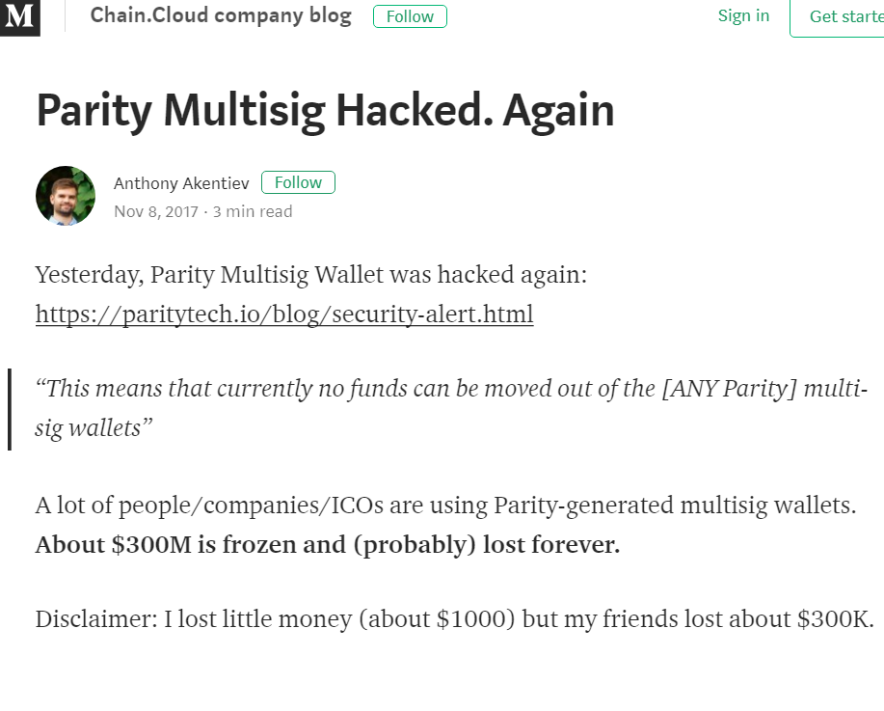
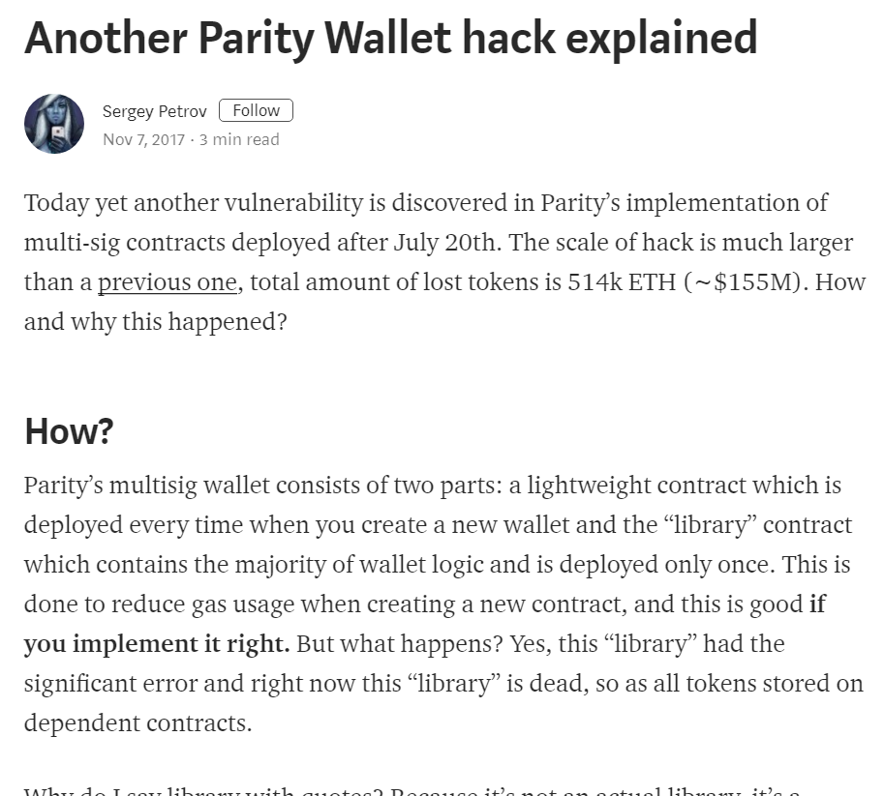
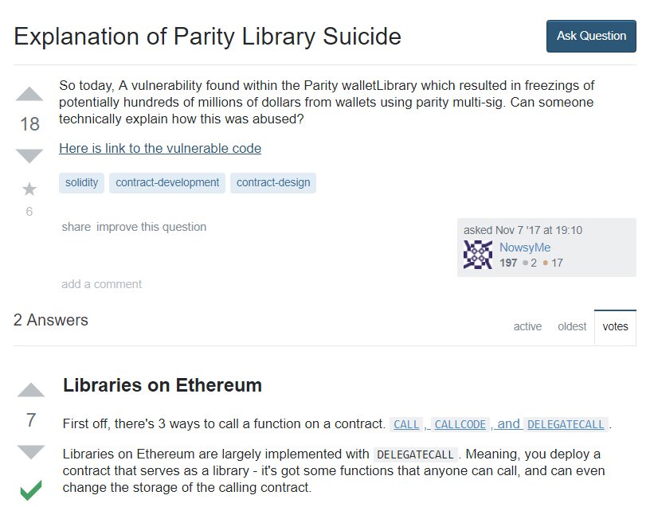
This Happened
About $300M (at the time) burned

Slide 73
Prevention
Any number of changes to library
initializing it
no selfdestruct() function
Declaring a contract a library enforces statelessness

Slide 74

Ideas we covered in this lecture
Smart Contract Language Design
Re-Entrancy Attack
Silent Overflow Attack
Unexpected Ether Attack
DelegateCall Attack

Slide 75
